Slide 1









Introducing the Software Sustainability Institute Date, Meeting, Location Name (@ID), Organisation ORCID: 0000-0000-0000-0000 | email@my.domain
Supported by
Project funding from
Slides licensed under CC-BY where indicated:

Slide 2

Software Sustainability Institute
“A national facility for cultivating better, more sustainable, research software to enable world-class research”
Providing to the wider community:
expertise, services, tools, events, policy, guidance, data, opportunities, …
Supported by EPSRC/ESRC/BBSRC grant EP/N006410/1, with additional project funding from Jisc and NERC.
Collaboration between the universities of Edinburgh, Manchester, Oxford and Southampton.

Slide 3
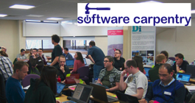


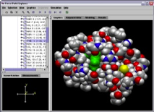
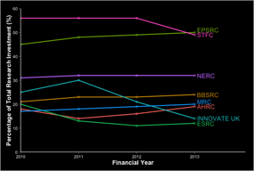
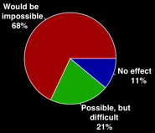
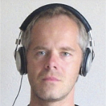
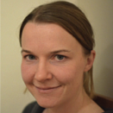
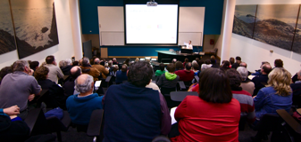


Software
Training
Helping the community to develop software that meets the needs of reliable, reproducible, and reusable research
Delivering essential software skills to researchers via CDTs, institutions & doctoral schools
Outreach
Exploiting our platform to enable engagement, delivery & uptake
Collecting evidence on the community’s software use & sharing with stakeholders
Bringing together the right people to understand and address topical issues
Policy
Community

Slide 4

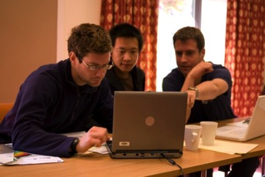
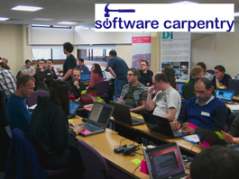



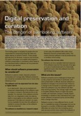
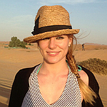


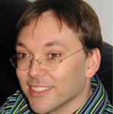



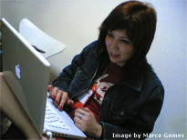
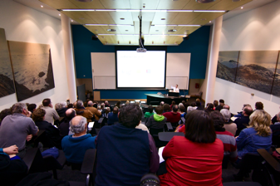
Software
Training
Advice
Courses
100+ UK SWC workshops
2500+ learners
Consultancy
70+ projects
200+ evaluations
4 surgeries
Guides
Outreach
80+ guides
50,000 readers
Website & blog
200+ contributed articles
20,000 unique visitors per month
4,000 Twitter followers
Research
740 researchers 50,000 grants analysed
Campaigns
Workshops
Fellowship
80+ domain ambassadors
500+ RSEs engaged
2100 signatures
13 issues highlighted
Policy
Community
25+ workshops organised

